Slide 1
MakeAChange Website
(Front-end Project)

Slide 2
Team : Amigos
Members:
Vara lakshmi - 11601670
Shashi bhushan - 11604333
Shubhanginiee Badola- 11602118

Slide 3
About MakeAChange
It creates a medium between NGO’s and Youth to bring connection which can enable them create greater impact on society.
Projects ongoing are available which are working on 17 SDGs released by United Nations.
Anyone all around the world can become a part of this community by donating or working in that projects.
Every project success is being measured by us and updates are uploaded on website.

Slide 4
Process
Projects from all over cities in the country are uploaded and can be registered online through website.
They all will be contacted directed from the database and will go through a small phonic interview to get themselves approved for the project.
Once they get accepted, they will receive a mail on selection with fixed dates.
A certificate will also be provided on completion of two or more weeks working on particular project.

Slide 5
Languages Used:
Bootstrap
HTML5
CSS3
Javascript
Jquery

Slide 6
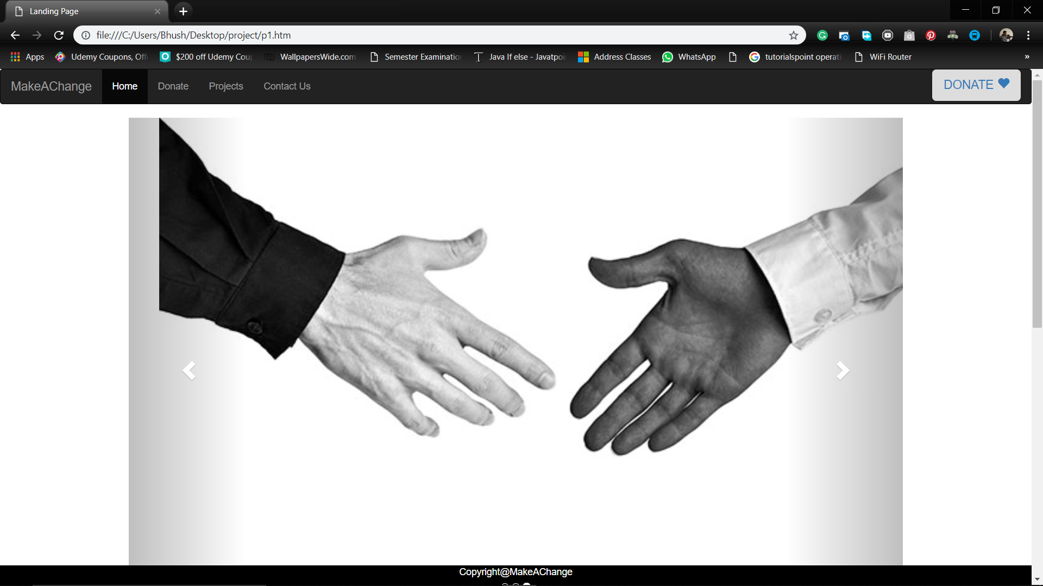

Slide 7
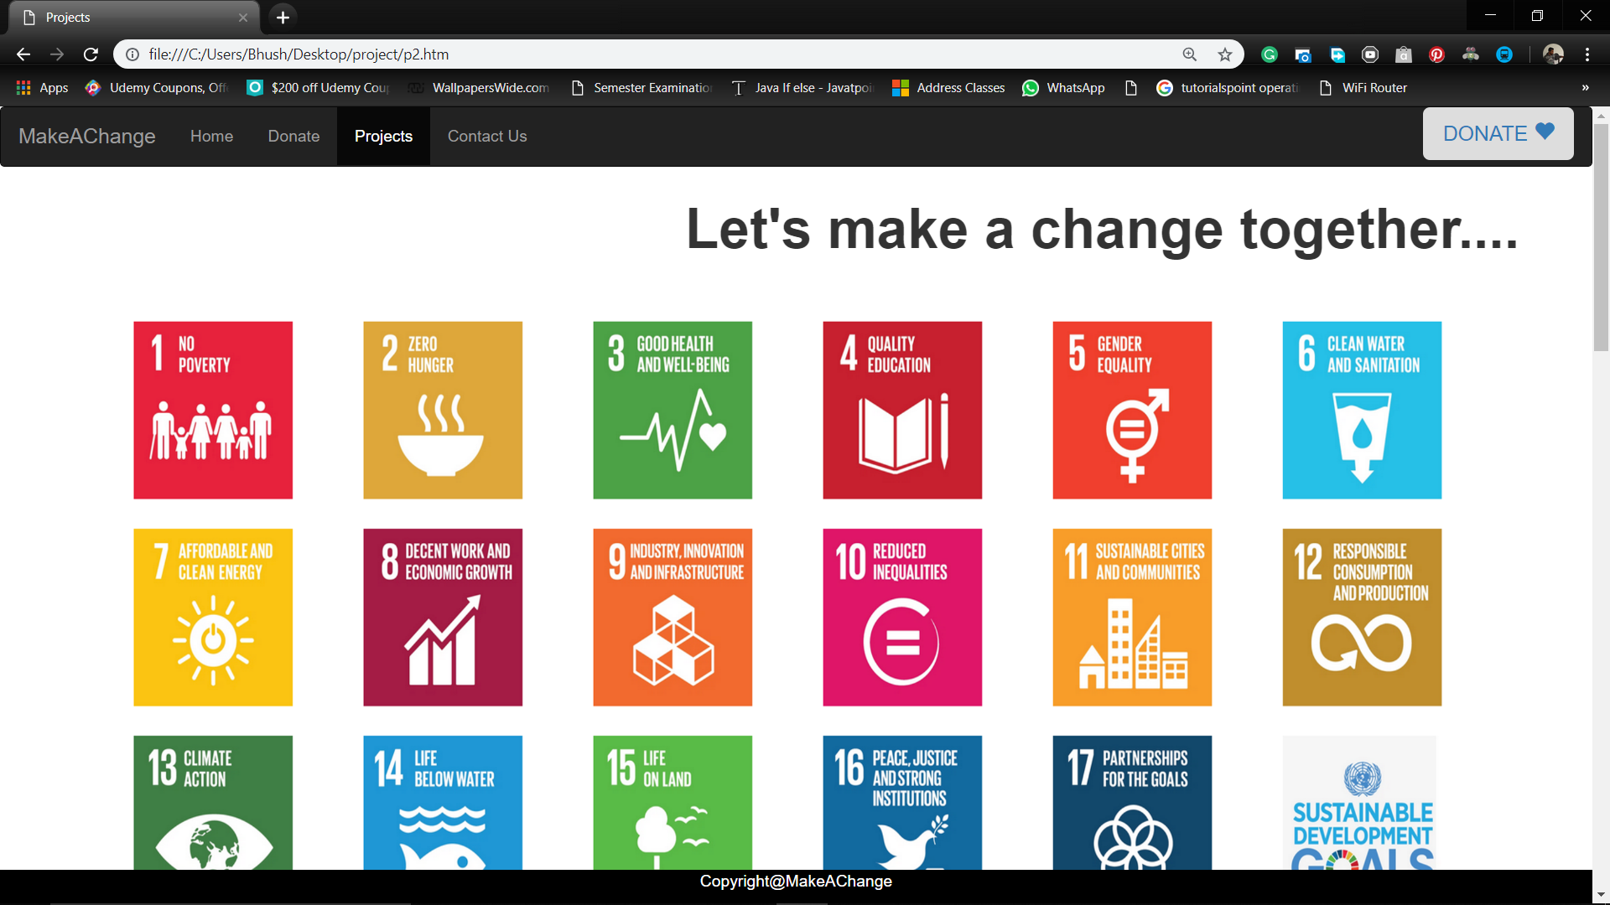

Slide 8
Let’s move to demo!!

